Slide 1
The iPad for Lawyers: Incorporating Tablet Computing Into Your Practice
ABA Forum on the Construction Industry ABA Law Practice Management Section February 28, 2012

Slide 2
Your Speakers
Tom Mighell
Chair, ABA Law Practice Management Section
Author, iPad in One Hour for Lawyers, iPad Apps in One Hour for Lawyers
Jim Calloway
Director, Oklahoma Bar Association Management Assistance Program
Dave Owen
President, ImageServe
Business Technology Consulting

Slide 3
Our Agenda
Why the iPad? iPad v. Other Tablets
Essential iPad Basics
Accessories
Incorporating an iPad into Your Practice
Storing Files and Associated Security Issues
Securing Your iPad
Q&A

Slide 4
Why the iPad? The iPad v. Other Tablets

Slide 5
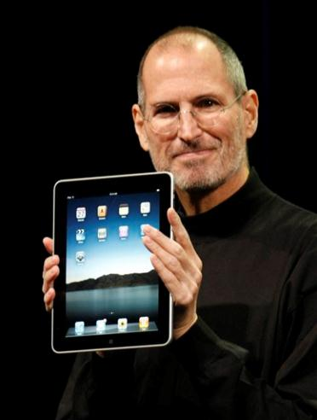
“Any sufficiently advanced technology is indistinguishable from magic.”
- Steve Jobs

Slide 6
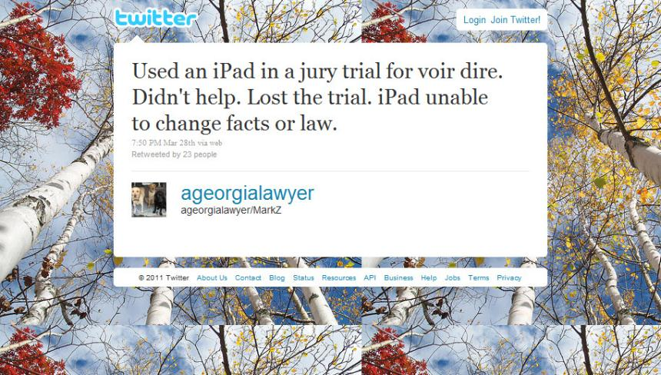

Slide 7
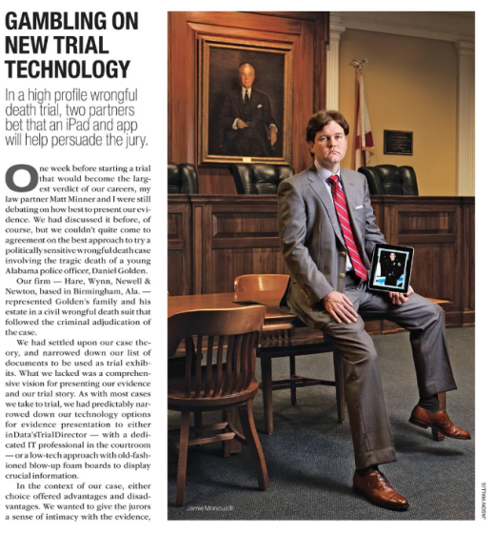
On the Other Hand…
$37.5 Million Verdict

Slide 8
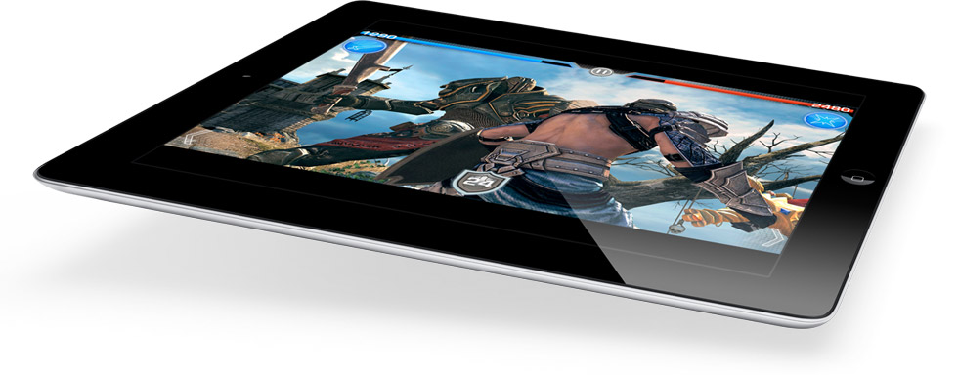
How is the
like
the
….?

Slide 9
Tablets – What’s Out There

Slide 10
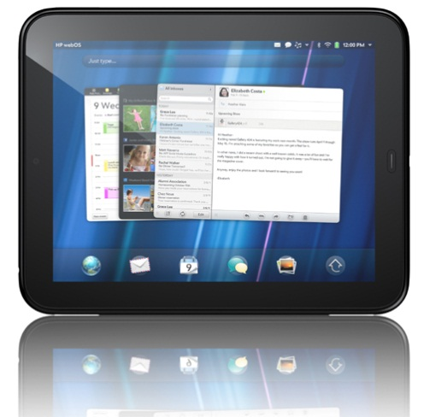
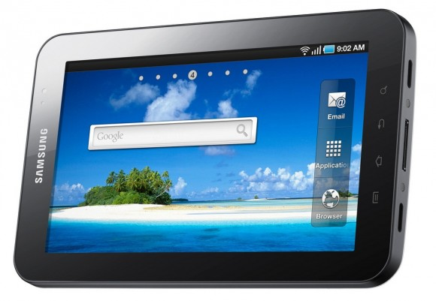
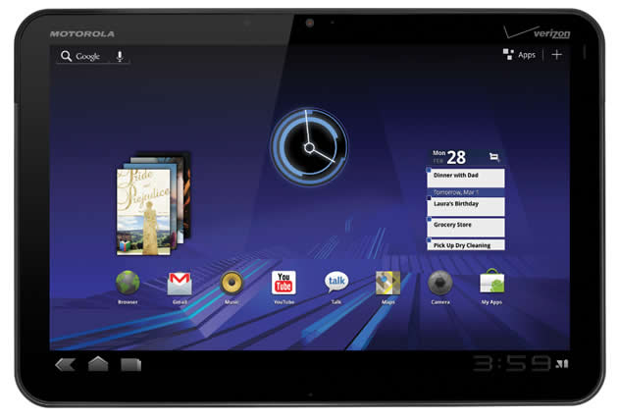
Android (Samsung Tab, HP TouchPad, Motorola Xoom)
Pros | Cons
Multi-Tasking | Battery Life
Supports Flash | Dangerous Apps?
USB/Device Ports | Google-Centric
More Customizable | Too Many Choices!

Slide 11
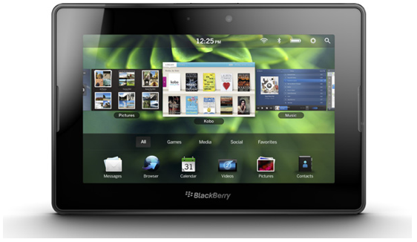
Blackberry (Playbook)
Pros | Cons
Blackberry name | Very limited app selection
Email security | Email doesn’t stay on device
Flash-enabled | Smaller Screen
Great Multi-Tasking

Slide 12
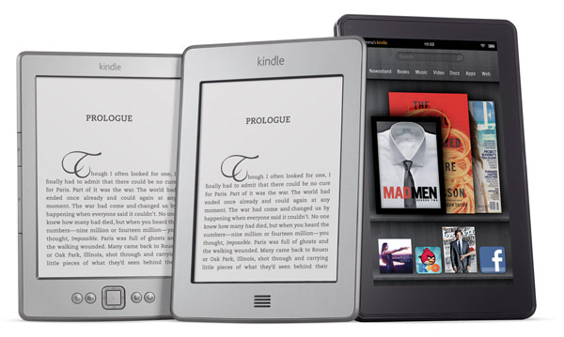
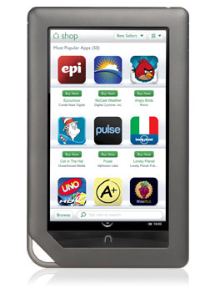
e-Readers, Contrasted

Slide 13
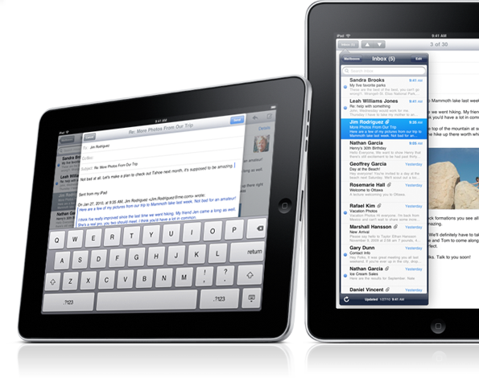
Apple iOS (iPad)
Pros | Cons
10-hour battery life | Clunky Multitasking
Superior App Store | No Flash
Legal-Specific Apps | No USB/device ports
It Just Works | It’s Apple’s World…

Slide 14
iPad – Which one to Buy?
Capacity | Wi-Fi Only | Wi-Fi + 3G
16GB | $499 | $629
32GB | $599 | $729
64GB | $699 | $829

Slide 15
Essential iPad Basics

Slide 16
Accessories

Slide 17
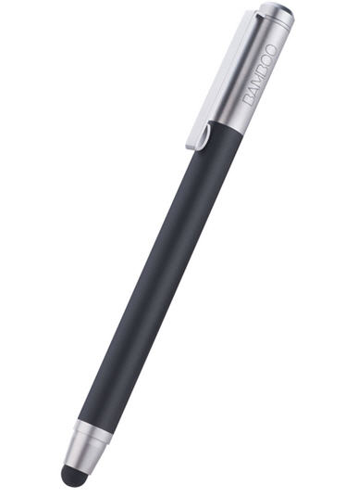
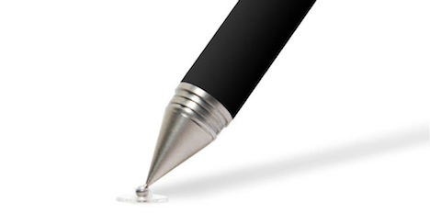
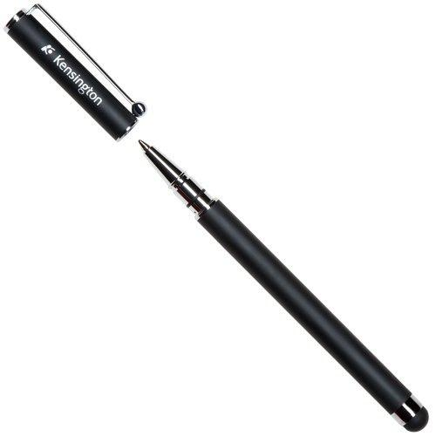
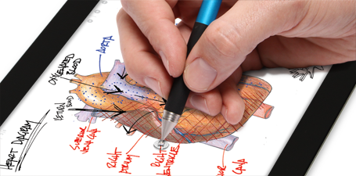
Accessories
Styluses
Adonit JotPro ($29.95)
Kensington Virtuoso
$25 with pen
$15 w/o pen
Wacom Bamboo
$29.95

Slide 18
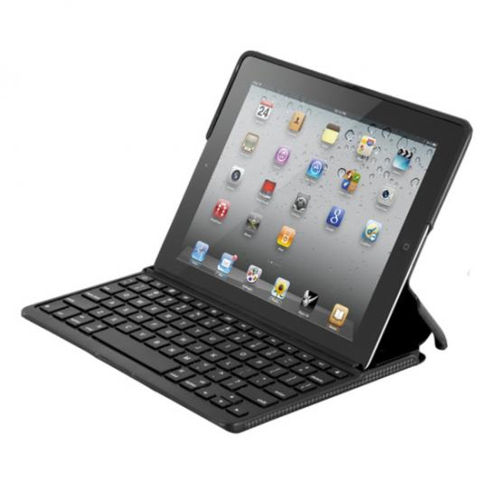
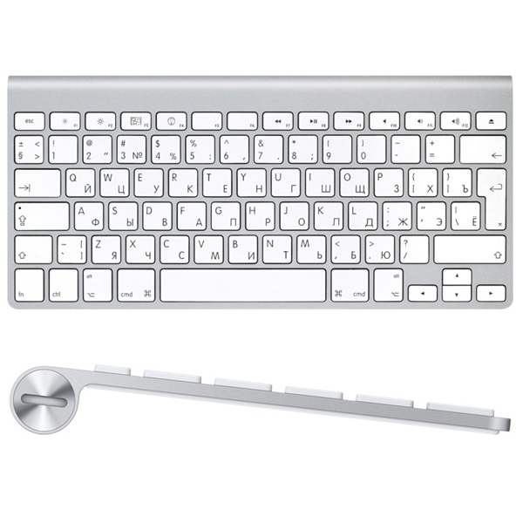
Accessories
Keyboards
Apple Wireless Keyboard ($69.95)
ZAGGFolio ($99.99)

Slide 19
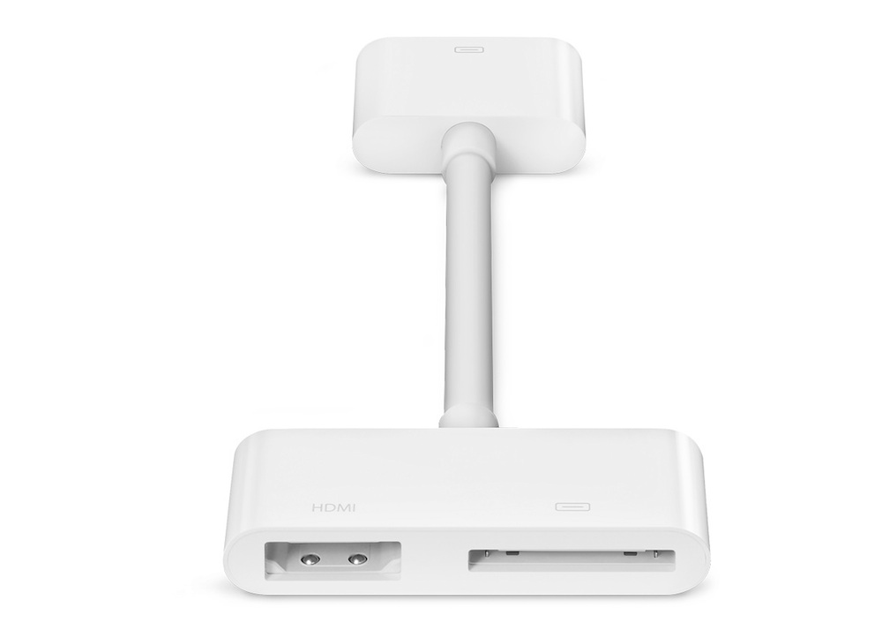
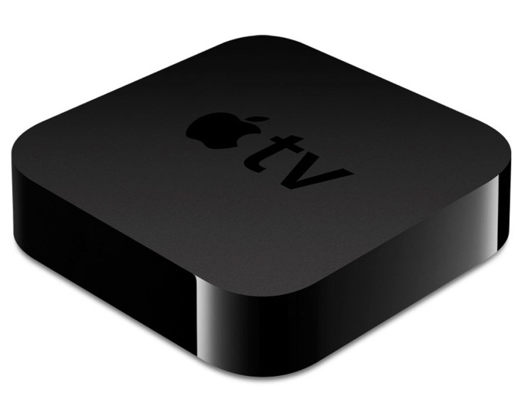
Accessories
Connections
HDMI Adapter ($29.95)
VGA Adapter ($29.95)
Apple TV ($99)

Slide 20
Incorporating an iPad Into Your Practice

Slide 21
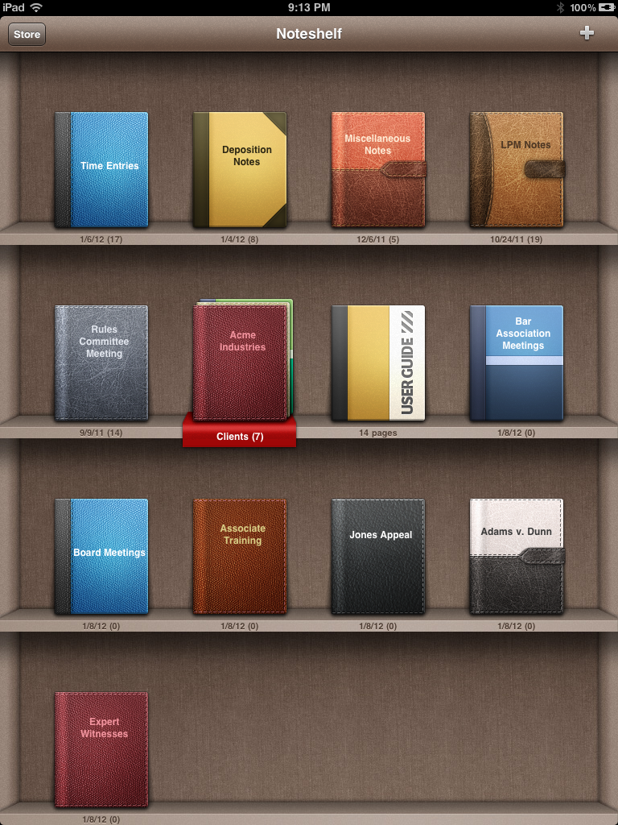
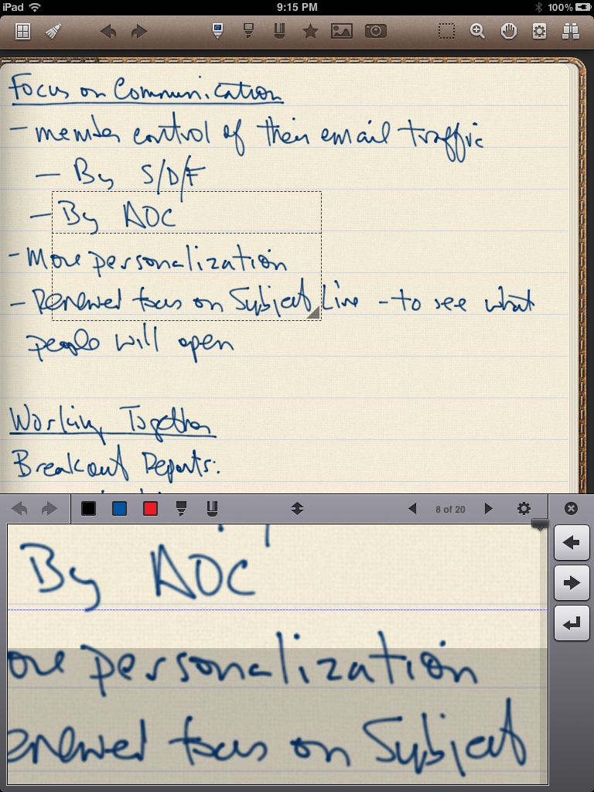
Note-Taking
Noteshelf

Slide 22
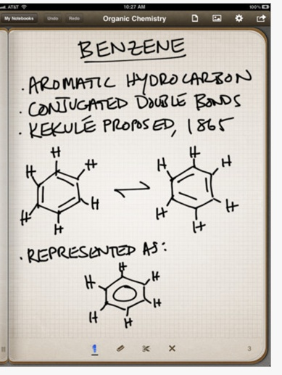
Note-Taking
Penultimate
An early note –taking app
Integrates with Evernote and Dropbox

Slide 23
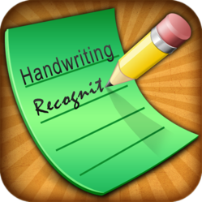
Note-Taking
WritePad

Slide 24
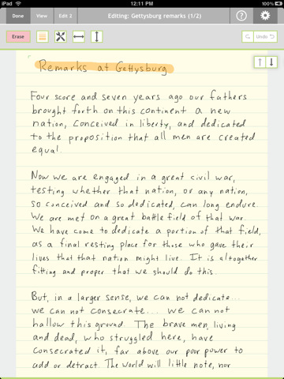
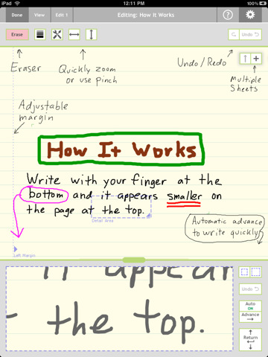
Note-Taking
Note Taker HD
You can fit more handwriting on a page with its writing area. Very popular app.

Slide 25
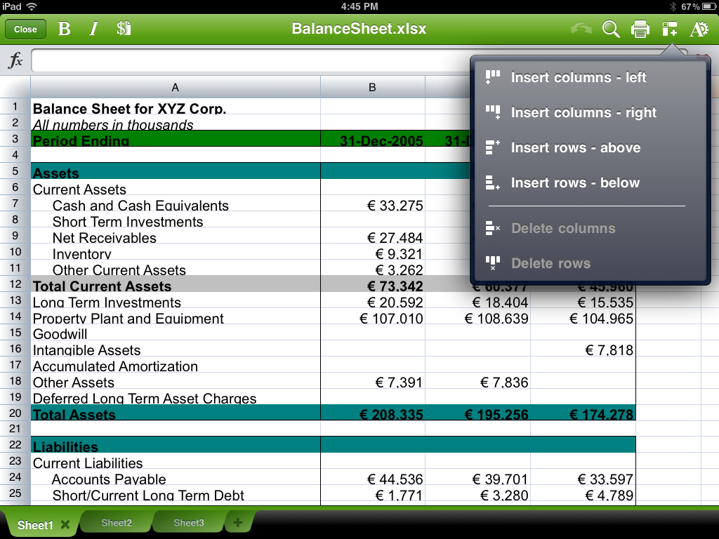
Document Creation/Editing
QuickOffice Pro

Slide 26
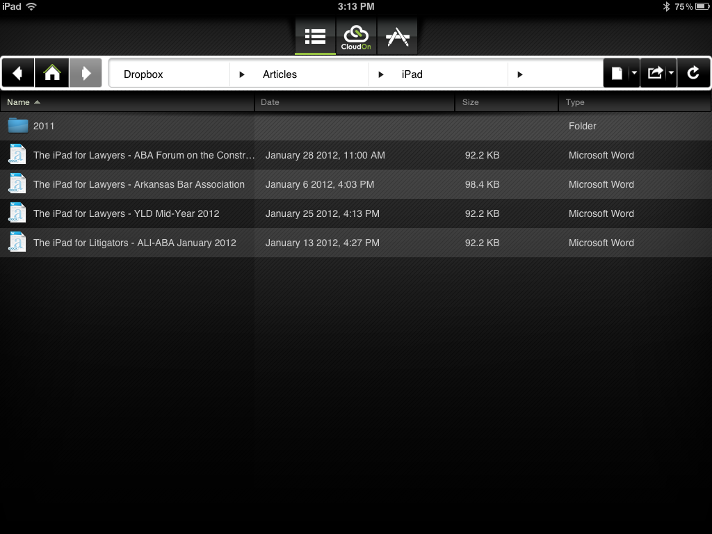
Document Creation/Editing
CloudOn

Slide 27
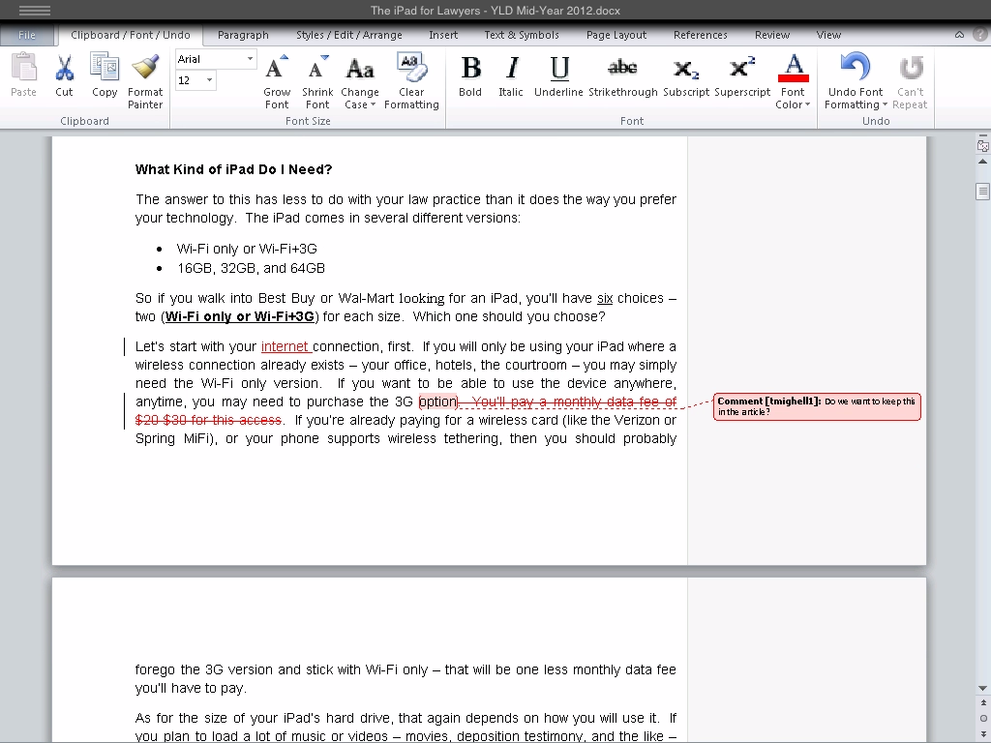
Document Creation/Editing
CloudOn

Slide 28
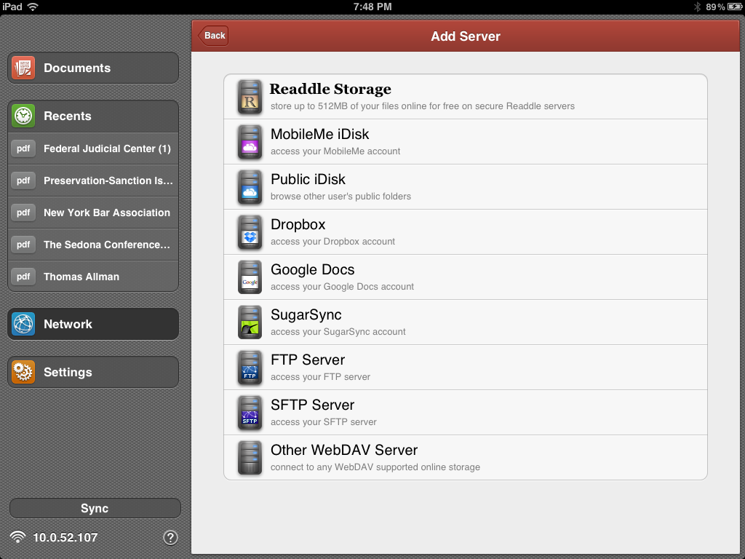
PDF Annotation
PDF Expert

Slide 29
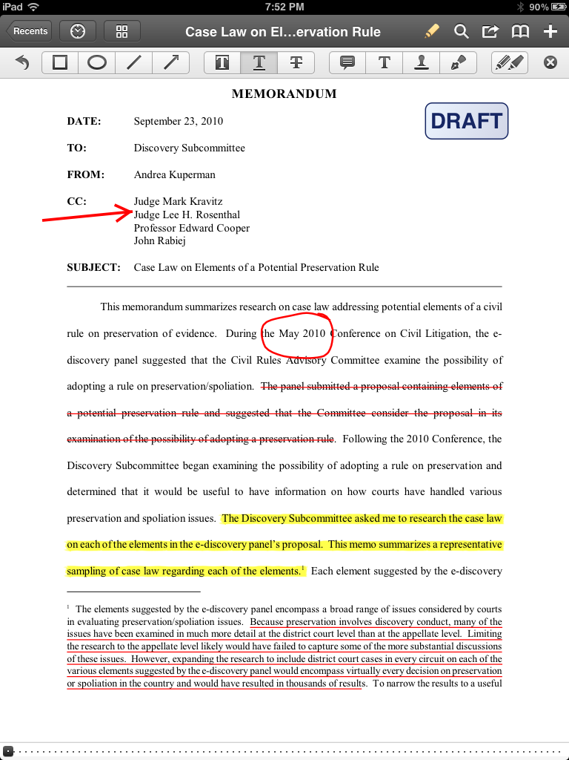
PDF Annotation
PDF Expert

Slide 30
Storing Files on Your iPad, and Security Issues

Slide 31
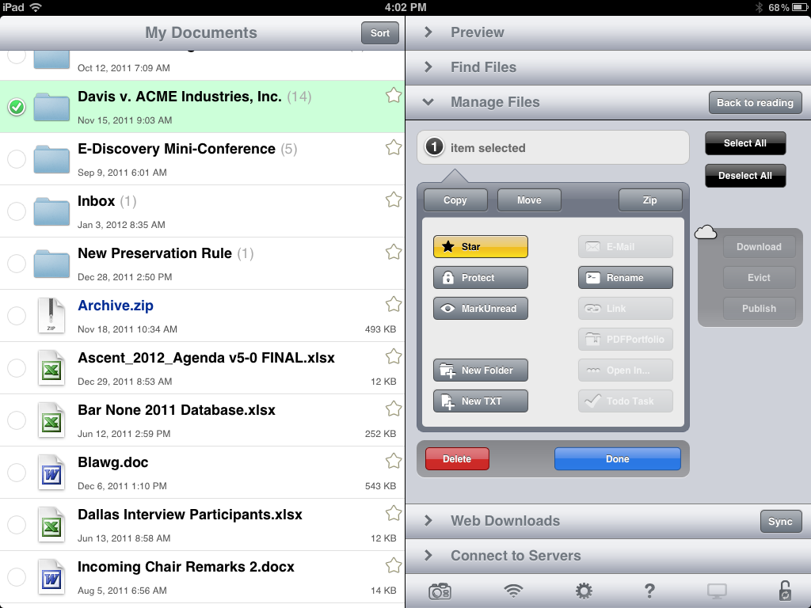
File Storage
GoodReader

Slide 32
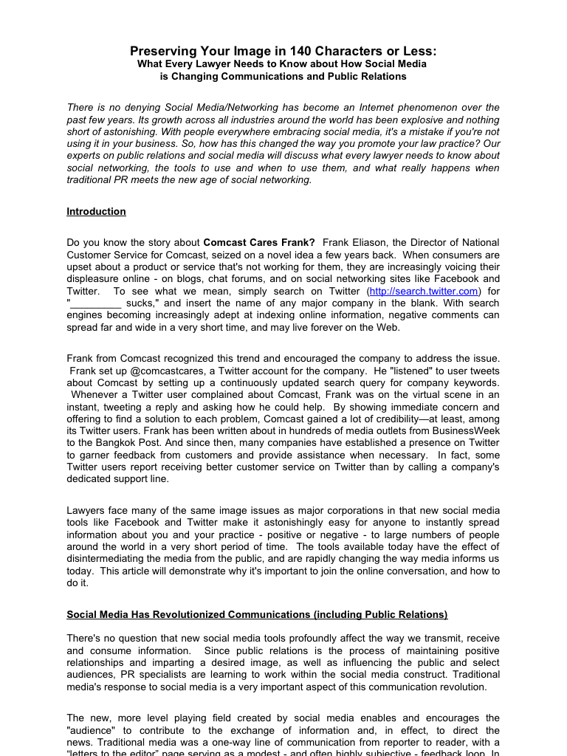
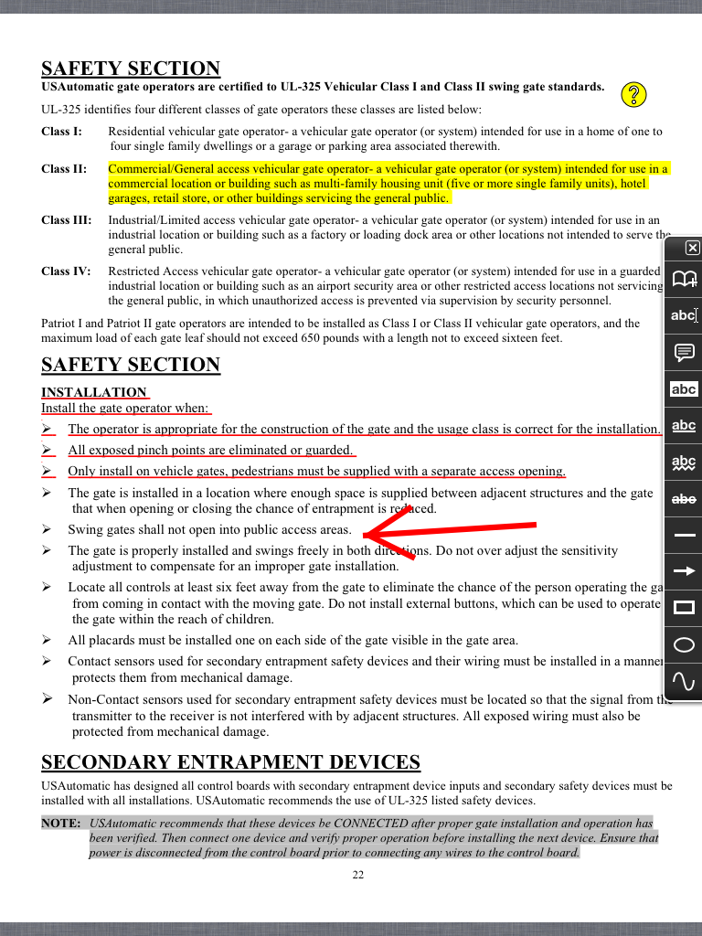
GoodReader
File Storage

Slide 33
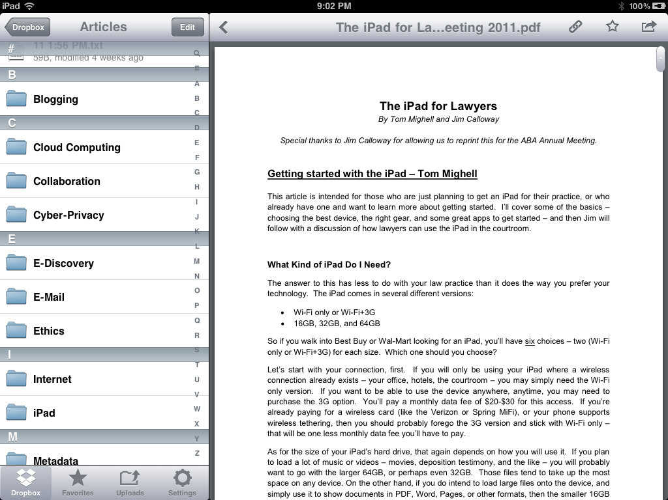
File Storage
Dropbox

Slide 34
Other Cloud Services
File Storage
Box
Sugar Sync
SpiderOaK

Slide 35
Security in the Cloud

Slide 36
Security in the Cloud
Encryption is a must
Ethical duties with entrusting information to third parties
“Informed consent” in fee agreements
Balancing different risks
Who holds the key?
Diligence in investigation and selection

Slide 37
Securing Your iPad

Slide 38
If you have an iPad Cover, Press ON
Set Auto-Lock to a Short Time

Slide 39
Consider a Longer Passcode
Move to ON

Slide 40
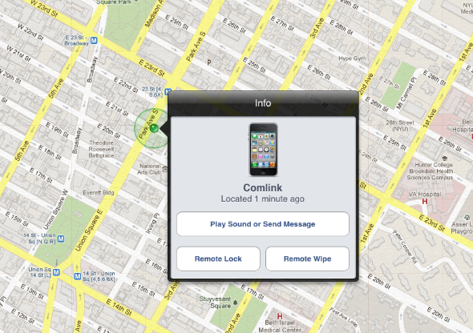
Find My iPhone

Slide 41
ABA Law Practice Management Section
www.lawpractice.org

Slide 42
Contact Us
Twitter: @TomMighell
Blog: iPad 4 Lawyers http://ipad4lawyers.squarespace.com
Twitter: @jimcalloway
Blog: Law Practice Tips http://jimcalloway.typepad.com
Dave@imageserve.com
Website: www.imageserve.com

Slide 43
Questions?

Slide 44
Downloads and CLE Information
www.imageserve.com/ipadforlawyers

